Slide 1
MANAGEMENT OF TECHNOLOGY – BPT 3113
TECHNOLOGY LIFE CYCLE

Slide 2
Chapter Outline
Introduction
Technological Progress
Technology Life Cycle
S-Curve
Market Growth
Product Life Cycle
Multiple-Generation Technologies
Technology and Market Interaction
Diffusion of Technology

Slide 3
Lesson Outcomes
Understand the context of technology life cycle
Explain the importance of technology life cycle for organization planning and strategic analysis
Know the process of technology diffusion

Slide 4
Introduction
The performance of a technology has a recognized pattern over time
Can be of great use in strategic planning
Neglecting this pattern as a key factor in the planning process may prove very costly to the competitive position of corporation
Managing technology requires deep understanding of the life cycles of the technology, product, process and system
The life span of various technologies can be conveniently identified as consisting of distinct stages

Slide 5
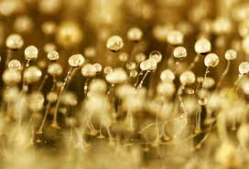
Stages in Technology Life Cycle
3-Stages | 4-Phases | 6-Phases
Embryonic | Innovation | Technology Development Phase
 | Syndication | Application Launch Phase
Growth | Diffusion Stage | Application Growth Phase
Maturity | Substitution | Mature-Technology Phase
 |  | Technology Substitution Phase
 |  | Technology Obsolescence Phase

Slide 6
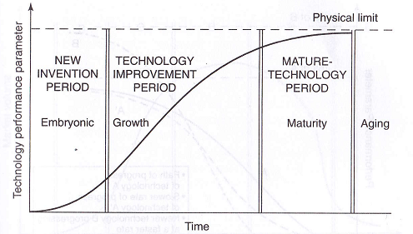
Technology Life Cycle : S-Curve

Slide 7
S-Curve : Technological Progress
A technology’s improvement of performance follows the S-curve
Technological performance can be expressed in terms of any attribute : aircraft speed in km per hour or number of transistors per chip
Innovation:
Represents the birth of new product / process resulting from R&D activities → spending significant amounts of effort and money to create the technology
Syndication:
Represents the demonstration and commercialization of a new technology → characterized by a period of slow initial growth

Slide 8
S-Curve : Technological Progress
Growth:
Represents the market penetration of a new technology through acceptance of the innovation by potential users of the technology → characterized by rapid and sustained growth
Maturity:
The period starts when the upper limit of the technology is approached and progress in performance slows down
Technology reaches its natural limits as dictated by factors such as physical limits
Example : Vacuum-tube technology was limited by the tube’s size and the power consumption of the heated filament – transistor technology will start a new life cycle
Concept in MOT : When a technology reaches its natural limits, it becomes a mature technology vulnerable to substitution or obsolescence

Slide 9
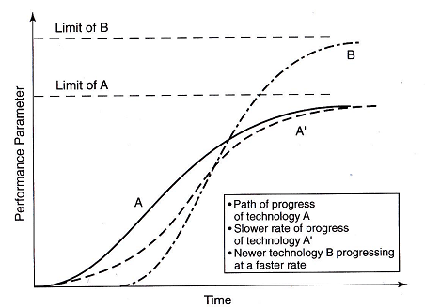
S-Curve : Technological Progress
A technology’s rate of performance improvement is dependent on the effort devoted to its development
Technology may progress on curve A or A’, depending on a number of factors including the type of the technology itself and the cost and time devoted to its development
A newer technology, B has a higher limit of performance for the same parameter – may progress at a faster rate and will influence the progression of A and A’
At a certain point in time it will replace the earlier technology
Changes in Natural Limits of Technology

Slide 10
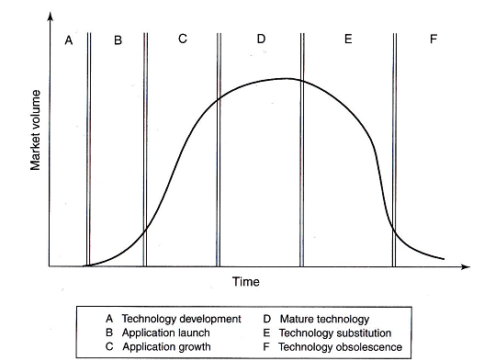
TLC & Market Growth
When technology reaches the market, it generates income
Market Growth at Different Stages of the Technology Life Cycle

Slide 11
TLC & Market Growth
Technology Development
Market does not recognize the technology at all
It has zero response
Spending significant amounts of effort and money to create the technology, develop prototypes and test the new technology – should reduce this time period
Application Launch
Market volume follows the path of technological progress
Characterized by slow initial growth followed by rapid growth
Application Growth
Penetration into the market will depend on the rate of innovation and the market needs for the new technology

Slide 12
TLC & Market Growth
Mature Technology
Growth rate slows down as the technology approaches its maturity
Market volume will peak and then start to decline
Technology Substitution
Companies that continue to use the old technology in this phase will be faced with a shrinking market share and fall in revenues
Technology Obsolescence
Technology has little or no value

Slide 13
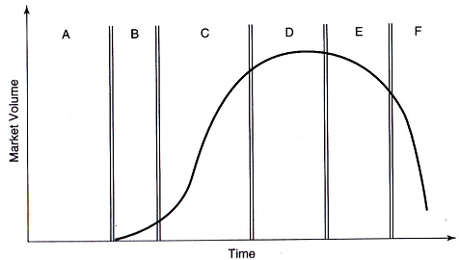
Product Life Cycle
A : Concept Design Prototype
B : Product Launch
C : Product Growth
D : Mature Stage
E : Substitution Products
F : Product Obsolescence

Slide 14
TLC with Process Innovations
Progress of technology is shown in relation to product and process innovation

Slide 15
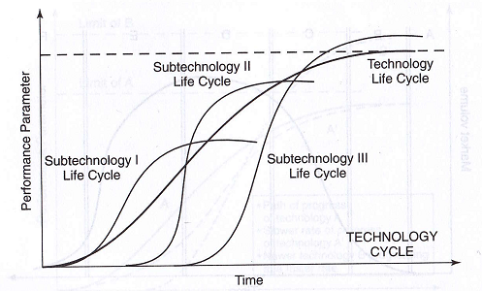
Multiple-Generation Technologies

Slide 16
Multiple-Generation Technologies
Technology has a hierarchy
System → No. of Subsystem → No. of Components
Technology can consist of multiple technologies and derive from different generations of innovation
Example:
System – Computer
Subsystem – Microprocessor (286, 486, Pentium, Core 2)
Each of these generations of innovation helped boost the technology life cycle

Slide 17
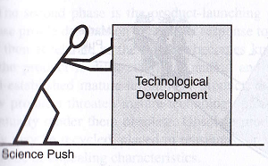
Technology and Market Interaction
Science-Technology Push
Science provides the base for technological development which in turn creates new markets
Innovations that ensued from the technologies caused major industry upheavals and totally changed the markets
Technology | Scientific Discovery
Nuclear energy | Based on Einstein’s 1905 paper, which established the equivalence of mass and energy
Transistors | Based on A.H. Wilson’s 1931 theory of semiconductors
Electronics | Based on Maxwell’s theory of electromagnetism, developed in the 1880s
Genetic engineering | Followed Watson and Crick’s 1952 discovery of the structure of DNA

Slide 18
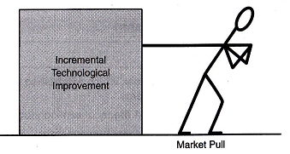
Technology and Market Interaction
Market Pull
Technology is often developed to meet a market need or demand – stimulated by consumers
Most of the technological developments stimulated by market pull are of an incremental nature or represent improvements to existing technologies
It have a cumulative effect and can have a tremendous impact on productivity and competitiveness
May provoke major breakthroughs when there is a strong collective demand for a solution to a specific problem. Example: Vaccine for H1N1

Slide 19
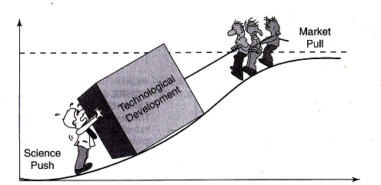
Technology and Market Interaction
Combined Effect of Technology Push and Market Pull

Slide 20
Technology and Market Interaction
Innovation
Opportunities for Technology Push
Opportunities for Market Pull
Integrating Technology Push and Market Pull to Stimulate Innovation
Scientific discoveries
Applied knowledge
Recognized needs
Intellectual capital
(scientists & engineers)
Market demand
Proliferation of
application areas
Recognized needs
Opportunities for
increased profitability,
quality & productivity
Entrepreneurs

Slide 21
Diffusion Of Technology
Diffusion is the process by which an innovation is communicated over time through certain channels to members of a social system [Rogers, 1995]
Rate of adoption of an innovation by members of a social system is dependent on the degree to which the innovation:
Is perceived to be offering better advantage than does existing practice
Is compatible with the values and needs of the users
Is considered complex and difficult to use
Can be introduced on a trial basis before users must fully commit to its adoption
Is seen and its results are observed by potential adopters

Slide 22
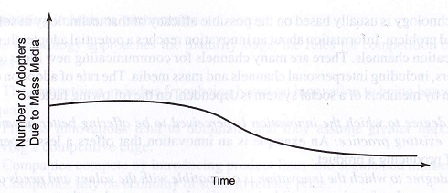
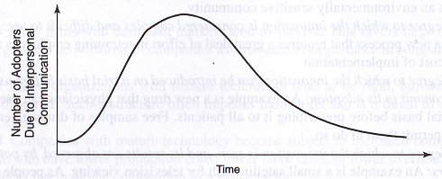
The Diffusion-Communication-Channel Relationship
Adopters of an innovation are influenced by two types of communication channels:
Interpersonal word of mouth
Number of users expands during the early phase of the diffusion process and declines during the second half
Mass media channels
Greatest in the early phase of diffusion but occurs continually throughout the diffusion process

Slide 23
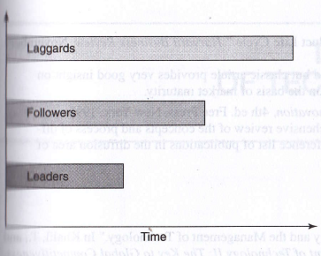
The Diffusion-Communication-Channel Relationship
The decision to adopt an innovation by an individual or an organization takes a certain period of time and consists of several stages
Innovation Decision Time

