Slide 1
Critical Factors in Managing Technology
BPT 3113 – Management of Technology

Slide 2
Chapter Outline
Industry Needs in MOT *
Technology and Its Enablers *
Changing Trends in Industry *
Issues in Managing Technology *
Determinants of Nation’s Capability *
Managing Change *
Bringing Innovation to Market *

Slide 3
Lesson Outcome
Understand needs in managing technology
Know the issues in managing technology
Explain requirements in managing change

Slide 4
3
Technology Management
The role of technology in creating wealth
Critical Factors in Managing Technology
2
1

Slide 5
Industry Needs in MOT
Identified by National Research Council (1987)
How to integrate technology into the overall strategic objectives of the firm
How to get into and out of technologies faster and more efficiently
How to assess / evaluate technology more effectively
How best to accomplish technology transfer
How to reduce new product development time
How to manage large, complex and interdisciplinary or inter organizational projects/systems
How to manage the organization’s internal use of technology
How to leverage the effectiveness of technical professionals

Slide 6
Technology & Its Enablers
Issues falling under the scope of MOT can be categorized as follows:
Methods and tools for effective management of resources
The business environment and the ability to manage the interface between the organization and the external environment
The structure and management of organizations
Management of R&D and engineering projects
Management of human resources under conditions of rapid technological and social change

Slide 7
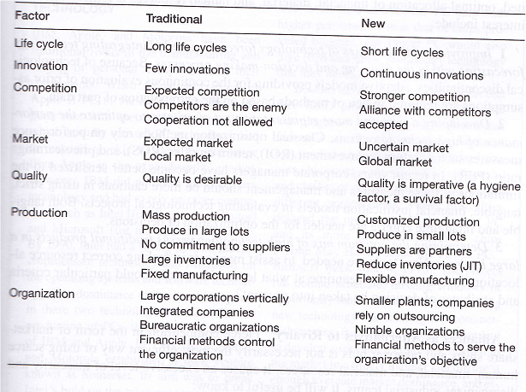
Changing Trends in Industry

Slide 8
Issues in Managing Technology
“The decline of U.S. industrial competitiveness in the 1970s and 1980s is widely perceived to have resulted not from an inability to develop new technologies but from the failure to manage available and emerging technologies in an effective and timely manner”
The unifying theme for the entire field of MOT is ‘technology as a creator of wealth’
The concern is the conditions dictated by changes in technology and by the global business environment

Slide 9
Issues in Managing Technology
Resources
The Business Environment
The Structure & Management of Organizations
Project Planning & Management
Management of Human Resources

Slide 10
Resources
Managers that live in competitive environment must be equipped with predictive methodologies and decision tools that are reliable, flexible, practical and fast.
Areas are considered critical:
Methods of Performance Assessment
The Measure of Performance of a Technology
The Measure of Benefits from R&D Activities
New Tools for Optimizing Decisions
Alliances as Alternative to Rivalry
Their continued research, validation, refinement and application deserve a high priority.

Slide 11
The Business Environment
To remain competitive, a firm must anticipate and evaluate technological opportunities before other firms attain an insurmountable competitive edge.
The following are considered priority issues:
The Integration of Technological and Strategic Plans
The Impact of Third Parties on Technological Change
Increasing the User’s Influence in the Selection and Application of Technologies
Decreasing Social Resistance to the Introduction and Adoption of Technology in the Workplace
Distributing the Benefits from New Technologies to Gain Acceptance
Other Areas of Concern to the Firm

Slide 12
The Structure & Management of Organizations
Installation of technological gatekeepers, the encouragement of internal entrepreneurship and the increase of joint ventures in both R&D and production have major consequences for organizational structure.
The following topics are viewed as priority issues:
Factors Leading to Reorganization of Technological Activities in Firms
Evaluating the Impacts of Reorganization on Technical Activities (R&D and Manufacturing Engineering)
The Effects of Different Organizational Structures on the Efficiency of the Product Development Cycle
Facilitators and Inhibitors of Technological Innovations and Transfer within Organizations
Documentation of the Decision Processes Leading to Organizational Changes

Slide 13
Project Planning and Management
Complex R&D projects require the mobilization of substantial resources and the coordination of activities.
Attention to the following items deserve special attention:
Project Portfolio Selection
Human Problems in Project Management
Initiation of Innovative Ideas in Organizations: Top Down or Bottom Up?
Creating a balance between these divergent views
Understanding the dynamics of this balance
Finding and evaluating existing patterns and identifying their impact on organizational performance
Postmortem Analyses of Projects

Slide 14
Management of Human Resources
Biggest challenge for organizations is harnessing and fully utilizing the capability of employees
Special attention should be accorded to the following points:
The Effects of Technological Change on the Skill Requirements of the Workforce
Matching and Training the Skilled Workforce to Meet the Requirements of New Technologies
Obsolescence of Professional Staff and the Continuing Need for Professional Development Activities
The Role of Technological Gatekeepers and Internal Entrepreneurs
Social Consequences of Technological Change
Other Areas of Importance

Slide 15
Determinants of Nation’s Capability
Scientific and Technological Capability
The strength of the national research
Market Demand
The scale of domestic markets
The openness of global markets as engines for innovation and its commercialization
An Agent That Transforms This Capability into Goods and Services
Synergy between basic research and downstream technical activities such as design and production capabilities
Ability to continually modernize plant and equipment
The quality of technical education
The strength of information technology infrastructure

Slide 16
Managing Change
Managing Operation | Managing Innovation
Creating Today’s Revenue | Creating Tomorrow’s Revenue
Single Route and Result | Multiple Routes and Results
Driven by Functional Teams | Driven by Cross-Functional Teams
Clear, Shared Goals | Unclear, Often Conflicting Goals
Traditional Players & Roles | New Players & Role
DOING THING RIGHTS | DOING RIGHT THINGS

Slide 17
Managing Change
1
2
3
Strategy
Innovation
Innovation
Cycle
Innovation
Process

Slide 18
BRINGING INNOVATION TO MARKET
4
Gap between suppliers
and demanders
3
Product
Price
Place (distribution)
Promotion
4Ps Marketing Strategy
2
Market Positioning
1
An effort to influence consumer perception of a brand or product relative to the perception of competing brands or products
Product Definition

Slide 19
Summary
Organization will loose their competitiveness if fail to manage technologies in an effective and timely manner
5 essential issues in managing technology
A new managing style to adapt the changes is require for organization survival in current environment

