Slide 1
MANAGEMENT OF TECHNOLOGY BPT 3113
THE ROLE OF TECHNOLOGY IN THE CREATION OF WEALTH

Slide 2
Chapter Outline
Evolution By Age of Technology
The Creation of Wealth
The Evolution of Production Technology
The Evolution of Product Technology
Technology Role in Organization
Technology and National Economy

Slide 3
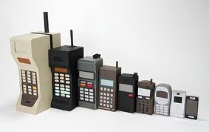
Lesson Outcomes
Identify the evolution of technology
Explain how technology role important to the creation of wealth

Slide 4
Evolution By Age Of Technology
Progress of civilization is frequently identified by the dominant technology of the age
The stone age
The bronze age
The iron age
The steam power age
The electricity age
The nuclear power age
The electronics age
The aerospace age
The information age
The biotechnology age

Slide 5
Evolution By Age Of Technology

Slide 6
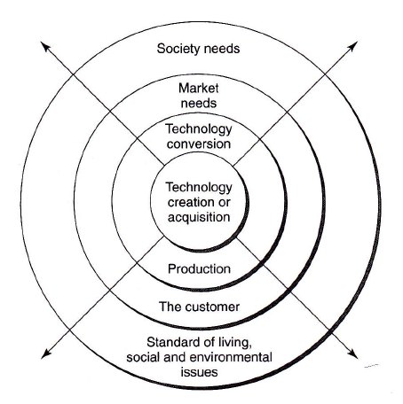
The Creation of Wealth
Technology generates wealth when it is commercialized or used to achieve a desired strategic or operational objective for an organization.
Spinning Out Technology

Slide 7
The Creation of Wealth
Adam Smith (British economist, 18th century) :
Economic Wealth (EW) is produced and distributed
Argued that capital is best employed for the production of wealth
Each nation should produce the goods in which it has absolute advantage
Joseph Schumpeter (German economist, 1928) :
EW is characterized by private initiative, by production for a market and by a phenomenon of credit
He also showed that industrial expansion is also the result of economic forces

Slide 8
The Creation of Wealth
Meanwhile, many economists determined economic growth by the rate of change in per capita real GDP
Robert Solow (1987 Nobel Prize in Economics) indicates that technological development will be the motor for EW in the long run
Boskin & Lau (1992) indicate that 3 principal sources of EW are enhanced capital, labor and technical progress
U.S National Science & Technology Council (1996) emphasized that technology is the engine of EW. It reported that “performance of individual companies is strongly linked to their use of technology”

Slide 9
The Creation of Wealth
Other factors that contribute to the wealth-creation system
Wealth Creation
Natural Resources
Market
Public & Environmental Policy
Capital
Labor
Technology

Slide 10
The Long-Wave Cycle
Improvement in productivity is vitally important to an economic system – technology is the driver
Emerging and new technology spurs economic expansion known as the long-wave or long economic cycle
Betz (1987) suggested that the process behind it is an interaction between technology, business opportunities the new technology creates and an eventual overbuilding of capital after the technology ages.

Slide 11
Long Wave Hypothesis [Betz, 1987]
Discoveries in science
Phenomenal base for technological innovation
Creates new products
Create new markets & industries
Expanding markets
Creating excess production capacity
Decrease profitability and increase business failures
May lead to depressions
New science & technology provide basis new economic expansion

Slide 12
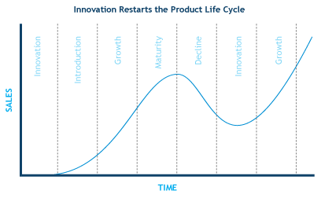
Long Wave Hypothesis [Betz, 1987]

Slide 13
Long Wave Hypothesis [Betz, 1987]
Cutting-edge technology is behind the long waves of economic activity.
High-technology products displace old technology when there is a justification for performance over cost.
Technology life cycles of industries affect long cycles in the national economy.
New technology comes from science and science comes from new discoveries in nature.
A new technology, when created, will began a new wave.

Slide 14
Evolution of Production Technology
1880
Agriculture Society – manual labor dominated
The Industrial Revolution – factory concept was born
1880 >
Scientific Management – introduced by Frederick Taylor
1900 >
Organizational Concepts
Motion Study – introduced by Frank & Lillian Gilbreth
Times Studies & Mass Production
Standardization, Assembly Line – introduced by Henry Ford
Piecework
Division of Labor, Labor Unions

Slide 15
Evolution of Production Technology
1920 >
Production Control & Management Planning
Queuing, Wage Incentive, Management Planning
1940 >
Tool Design, Human Factors
Inventory Theory, Layout, Material Handling
1950 >
Computerization, Reliability
Operational Research
Productivity, Engineering Economy
Statistical Analysis, Network Techniques
Statistical Quality Control (SQC) – introduced by Deming & Juran

Slide 16
Evolution of Production Technology
1960 >
Automation, System Design, Teleprocessing
Information Systems, Decision Theory, Simulation
1970 >
Control Theory, Large Scale System
Behavioral Theory, Personal Computers
1980 >
Technology Revolution
Total System Design, Social System, Cybernetics
System Engineering, Optimization Theory
Management of Technology

Slide 17
Evolution of Product Technology
1793 - 1829
Cotton gin (Whitney)
1830 - 1900
Telegraph (Morse), Improved plow (Deere)
1901 - 1939
Air Conditioner, FM Radio
First Flight (Wright Bros.), Model T (Ford)
Practical Steamboat (Fulton)
Steam Powered Locomotive for passengers and freight
Vulcanized Rubber, Internal Combustion Engine
Telephone (Bell), Radio (Marconi)
Helicopter, Jet Engine, Liquid-Fueled Rockets

Slide 18
Evolution of Product Technology
1940 - 1949
Color TV, Electronic Appliance
1950 - 1969
Sputnik 1 (USSR), NASA, Apollo XI
1970 onwards
Microprocessor, Recombinant DNA
Laser Printer, MRI Scanner, Space Shuttle
Digital Computer, Instant Camera
Jet Airliner, Transistor, Supersonic Flight
Integrated Circuit, Operable Laser, Fiber Optics
Telstar Satellite, First Man in Space
Scanning Tunneling Microscope

Slide 19
Technology Role in Organization
Provides Sustainable Competitive Advantage
Increases Productivity
Creates Profits
Protects from Obsolescence
Achieves Business-Market Fit
Enhances Motivation and Potential of Employees
Engine of Economic Growth
Improves Quality of Life

Slide 20
Technology & National Economy
Developed economies – countries that properly use technology for the creation of wealth
Less developed economies – countries lacking the technological know-how necessary to create wealth
U.S has the greatest technological edge in the world but Japan & Germany have manage their resources and technological systems better (achieved economic advantage)

Slide 21
Role of Government
Formulate policies to promote technology
Place strategic focus on right technology
Build technological capabilities
Safeguard interests of society
Provide resources
Strengthen education and entrepreneurship
Set up appropriate legal frame work
Establish networks

Slide 22
Summary
Not the technology itself create the wealth – it is the appropriate and effective use of such technology
Wealth is created on the basis of technology, production and smart work

Slide 23
Group Activities
Proper management of low or medium level technologies can still create a certain competitive advantage and be effectively used for wealth creation. In support of this point, one can observed the economic growth of newly industrialized countries (NICs), particularly those called the tigers of Asia such as Taiwan, Korea, Singapore and Malaysia. These countries have succeeded in acquiring low or medium level technologies and have done a credible job in managing technological resources. What strategy was followed by that country to become a competitor? Discussed the points.

Slide 24
Suggestion
Strategy that been used to become competitor:
Cheaper labor
Fewer regulatory restrictions
Strategic geographical location
Focusing niches where it can prosper
Excellent infrastructure
Stable currency

